Slide 1
M365 Copilot super user analysis

Slide 2
How to use this deck
This deck offers a starting point to craft a compelling narrative using insights from the Super User Report. The narrative structure is based on our learnings and is meant to guide—not prescribe—your storytelling. You can update the visuals using Power BI Live or static screenshots, and tailor the numbers and text to reflect your own findings.
The deck is organized into three sections:
Adoption Trends
ROI
Work Impact from Copilot
Feel free to mix and match pages to suit your audience and objectives.

Slide 3
1. Adoption Trends

Slide 4
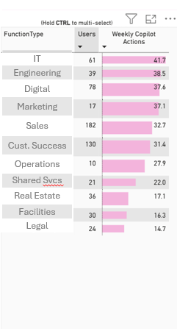
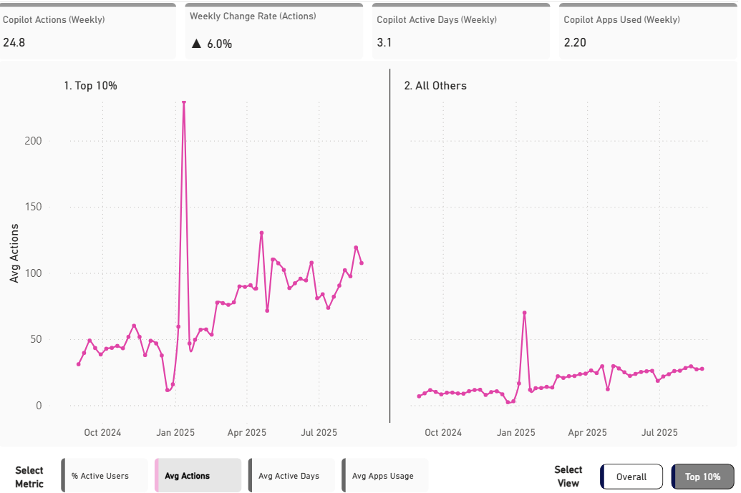
Copilot adoption is accelerating with a __% weekly growth
Adoption Trends
Weekly Copilot actions per person
Example visual
Takeaways
Copilot actions have risen at an average rate of __% each week and now stand at __ actions per user per week.
The Top 10% average __ actions a week, indicating what great looks like.
Average weekly active days is trending towards _, signaling Copilot becoming a daily habit.
__ group leads the way with __ weekly actions.

Slide 5
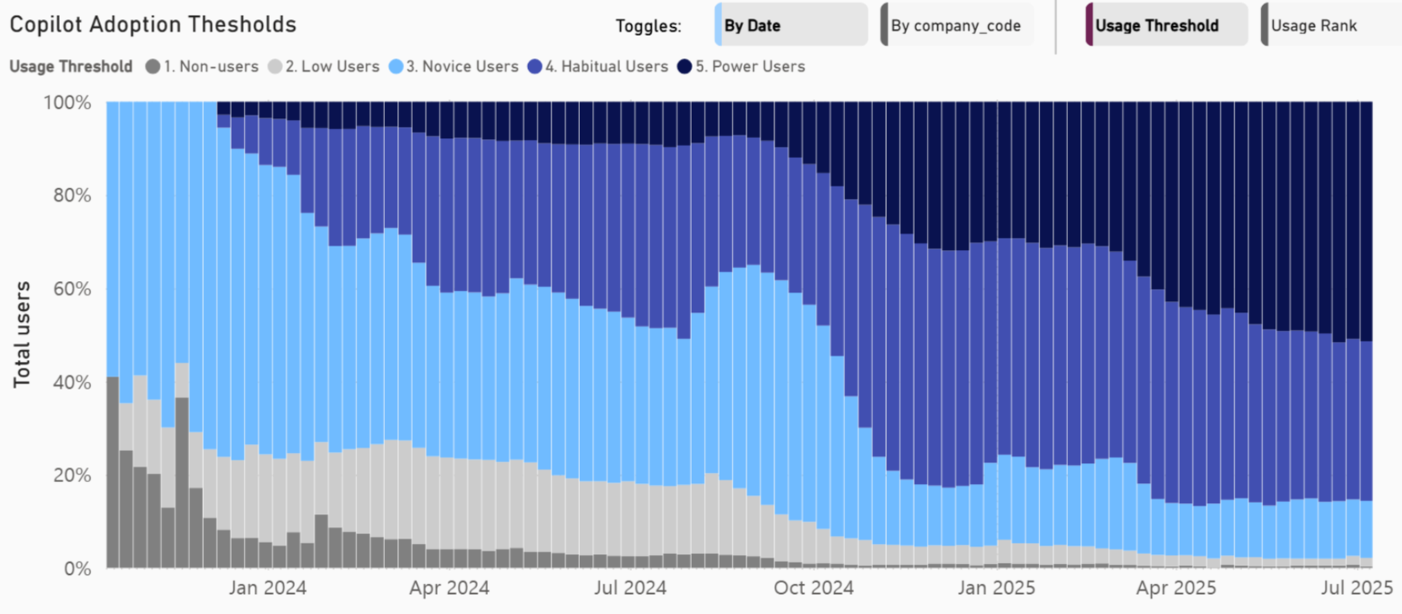
User momentum remains strong and climbing; novice user population remains sticky
Adoption Trends
Distribution of users by usage bands
Example visual
Takeaways
There has been a gradual shift toward more consistent and intensive usage patterns among users.
Power users and Habitual users now form over __% of licensed users.
In the last N months, the % of non-users has shrunk from X% to Y%.
__% are novice users, a population that has held relatively steady over the last __ months
Metrics
Power users: 20+ Copilot actions per week and habitual; Habitual users: Active in at least 9 out of 12 weeks; Novice users: Average at least 1 weekly action over the past 12 weeks; Low users: Having any Copilot action in the last 12 weeks; Non users: Zero Copilot actions in the past 12 weeks

Slide 6
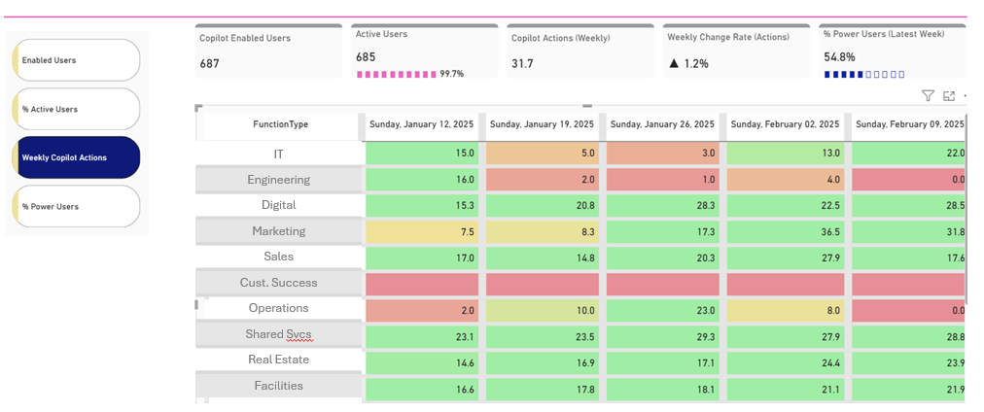
Initiatives with groups X and Y are yielding positive outcomes
Adoption Trends
Heatmap by various metrics
Example visual
Takeaways
Groups X and Y have shown a strong adoption pattern, increasing their weekly actions, and % active users.
This could be attributed to initiatives ___, ___, ___ and targeted learning content pushed to these groups.

Slide 7
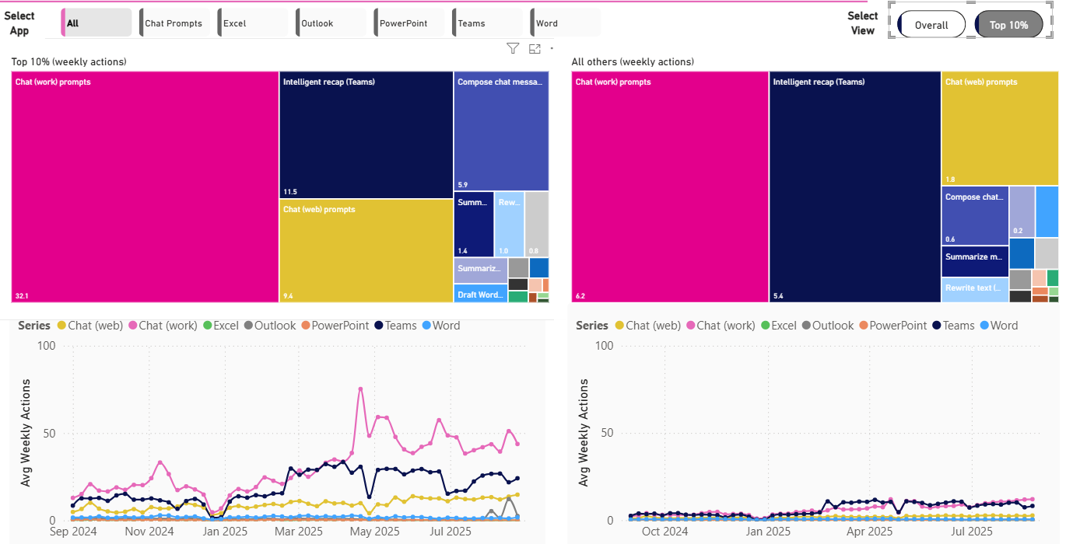
Copilot Chat (Work) usage intensity is a clear differentiator among super users
Adoption Trends
Actions driving high intensity usage
Example visual
Takeaways
__ actions drive over __% of all Copilot activity among super users (top 10%).
While the top actions are similar across super users and the rest, their usage intensity is __X more among super users.
There has also been steep growth in Copilot Chat (Work) usage among Top 10%.
Understanding the drivers behind these jumps offers clues to stimulating adoption in other areas.

Slide 8
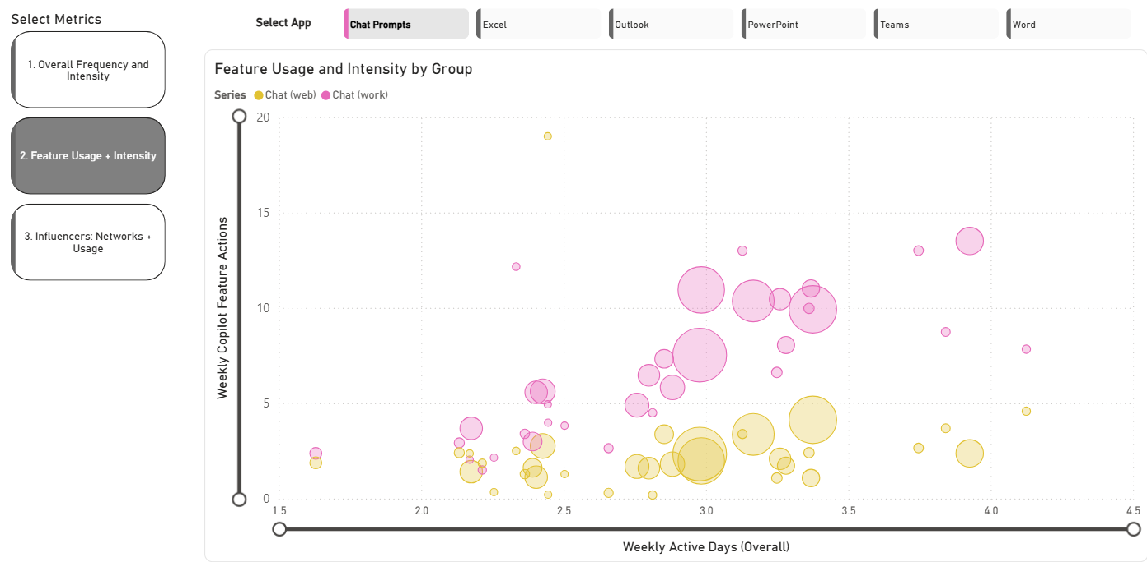
Adoption champions in X & Y can inspire other groups
Adoption Trends
Heatmap by various metrics
Example visual
Takeaways
Group X and Y lead the way with adoption of Copilot in Word showing consistent and high intensity usage.
There is an opportunity for Groups A, B, C with similar work charters to adopt best practices from these groups to drive usage.
Bubble size represents team size

Slide 9
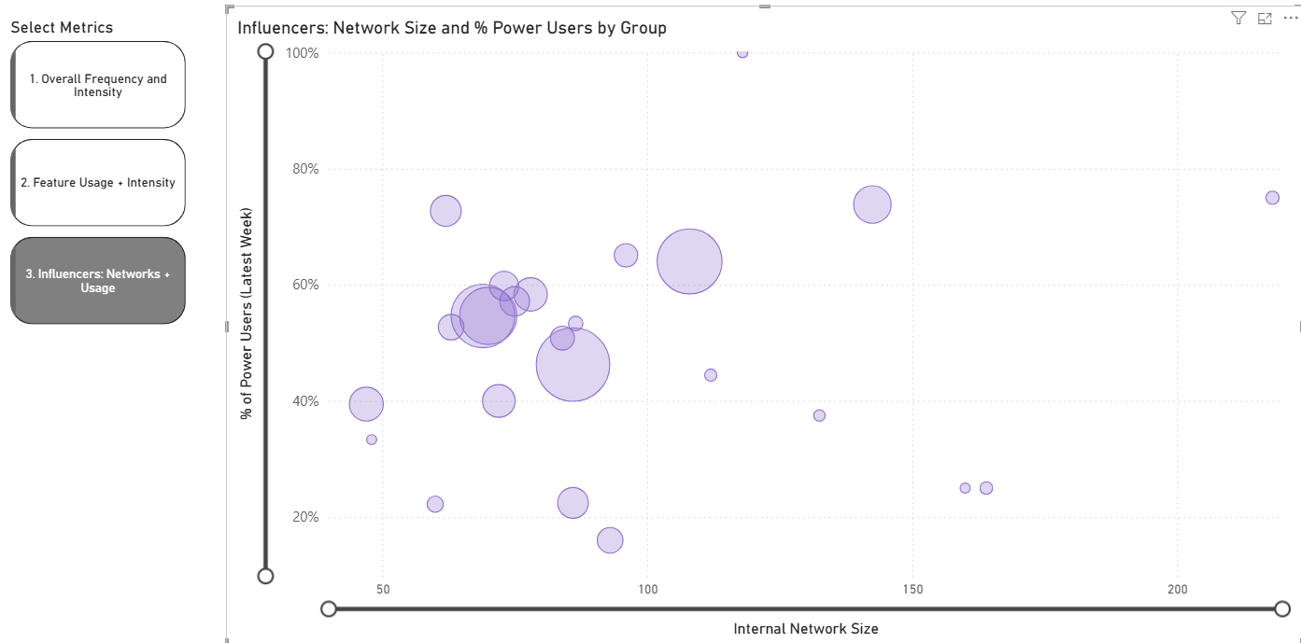
Opportunity to leverage network influence to grow usage
Adoption Trends
Heatmap by various metrics
Example visual
Takeaways
Group M and N are well connected with large internal networks but have low % of Power Users. Driving greater usage intensity among these teams can help spread best practices across connected groups.
Group J, K also indicate that role modeling from leadership teams is critical for sustained usage.

Slide 10
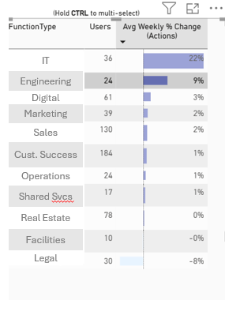
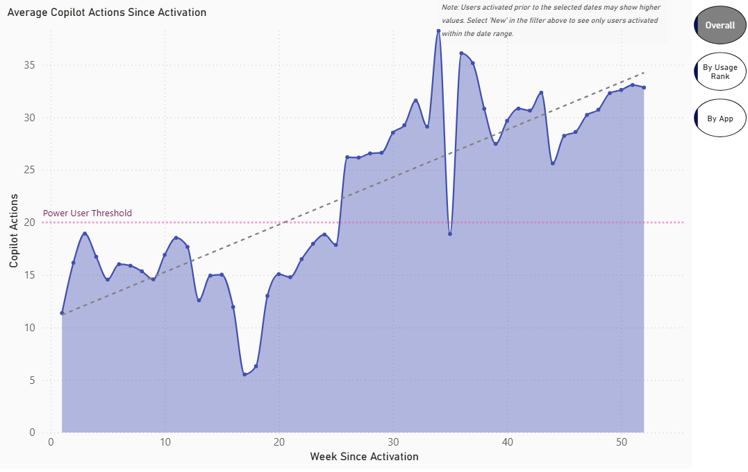
Org X shows the fastest ramp time to power usage (__ weeks)
Adoption Trends
Weekly Copilot actions by weeks since activation
Example visual
Takeaways
Linear calendar views mask growth due to rolling licensing; a ‘weeks-since-activation’ view reveals stronger adoption by aligning users from their start.
Ramp time to power usage is __ weeks.
Org X has shown the highest weekly acceleration with __% growth and reaching the power user threshold in only __ weeks.
Note
The view here is based on weeks since activation and not a chronological sequence.

Slide 11
2. ROI

Slide 12
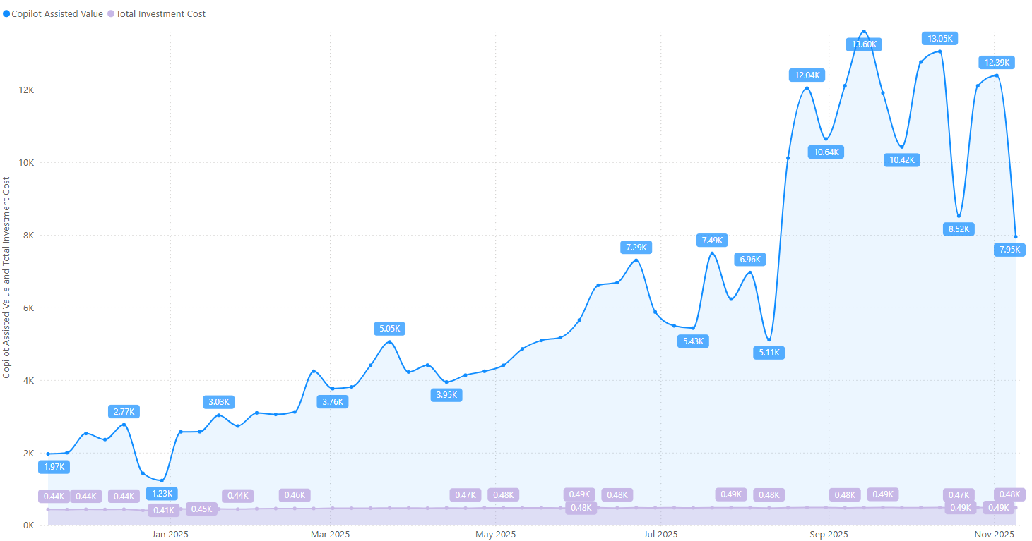
The gap between assisted value and investment is expanding rapidly with rising usage
ROI
Copilot Assisted Value Over Time
Example visual
Takeaways
Copilot provides an Assisted Value of $___K against an investment of $___K
This gaps continues to expand as usage intensifies

Slide 13
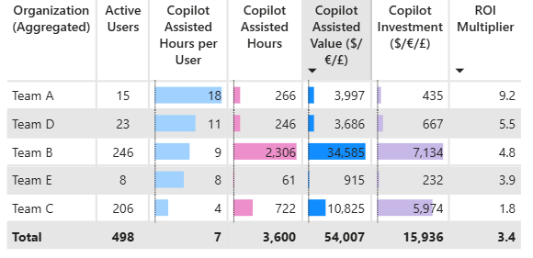
__ out of ___ teams are showing a positive ROI, with team __ leading the way with __X ROI multiplier
ROI
Copilot ROI by Teams
Example visual
Takeaways
Teams __, ___, ___ show a positive ROI multiple ranging between ___X to ___X
The overall ROI of Copilot is __X

Slide 14
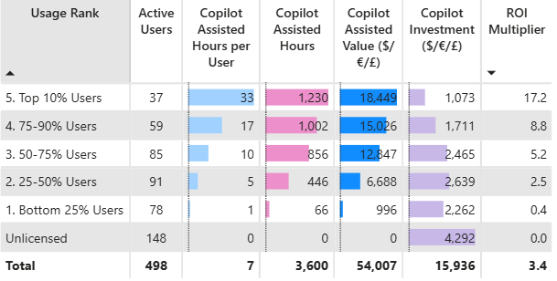
75% of users have an ROI multiple of __X or more
ROI
Copilot ROI by Usage Intensity
Example visual
Takeaways
Overall ROI of Copilot stands at __X of investment
Top 10% are getting deep productivity benefits with an ROI multiple of __X
Improving usage from bottom 25% and allocating licenses will improve the overall ROI further.

Slide 15
3. Work Impact

Slide 16
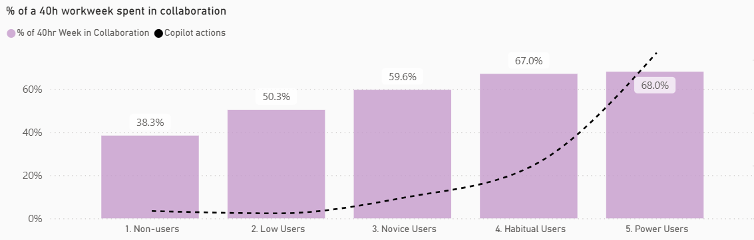
Evidence of more frequent collaboration among Power users
Impact
Change in collaboration (last month vs. first month)
Example visual
Takeaways
Habitual and Power are top collaborators - ~70% of time spent working with others

Slide 17
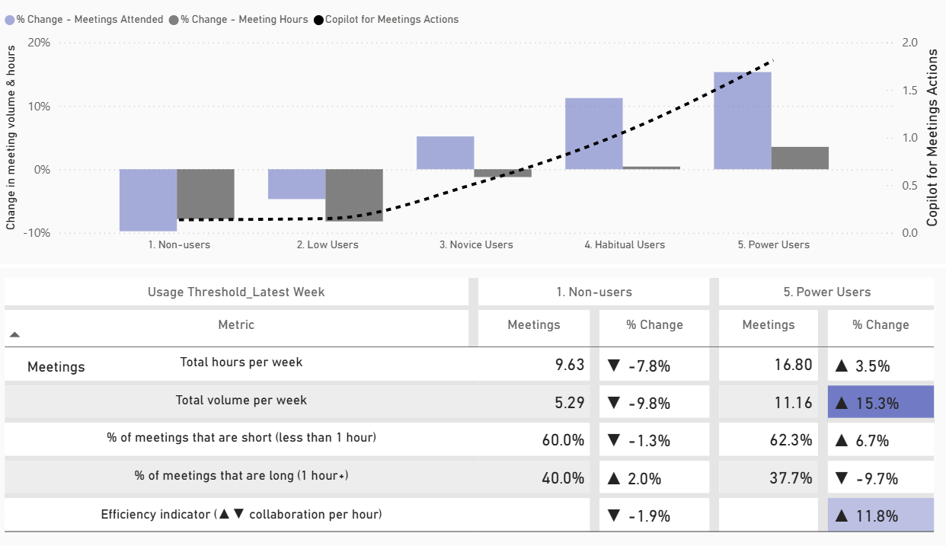
Power users become more efficient collaborators
Impact
Change in meeting behaviors (last month vs. first month)
Example visual
Takeaways
Copilot-for-meetings features enable shorter and more focused meetings compared to less frequent users.
Continued rise in meeting related actions of among most active users of Copilot

Slide 18
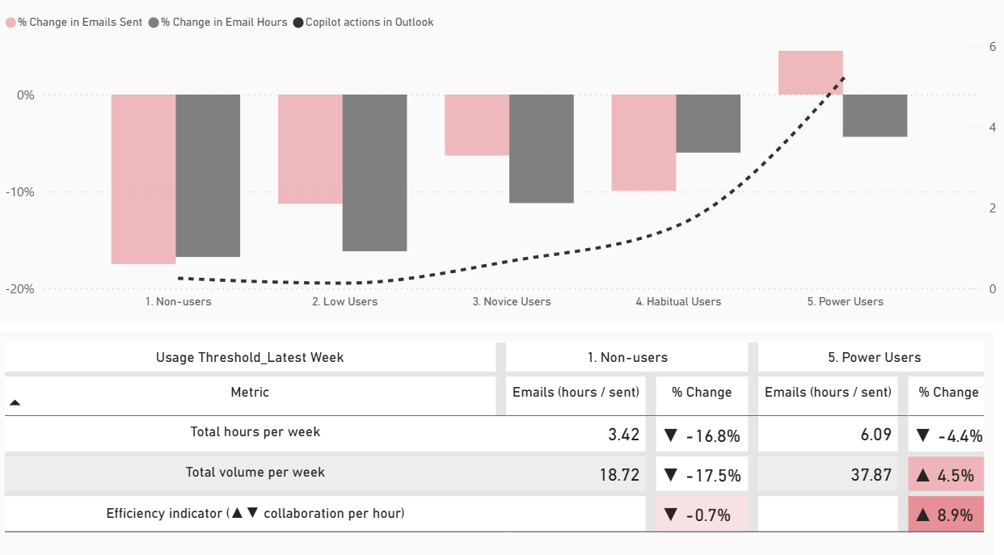
Email efficiency increases for Power Users
Impact
Change in email sent and email hours (last month vs. first month)
Example visual
Takeaways
Copilot features in Outlook enable Power Users to send and respond to more emails within a shorter time frame

Slide 19
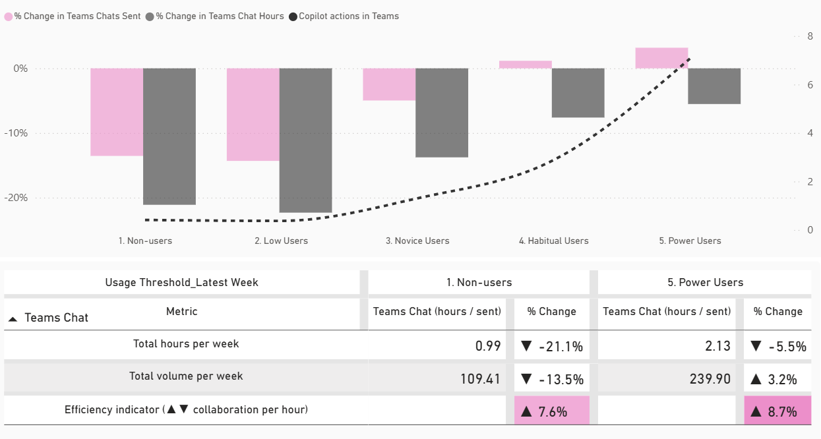
Collaboration efficiency translates to Teams communication
Impact
Change in messaging volume and time spent (last month vs. first month)
Example visual
Takeaways
Power users send more messages than before, however the time spent has reduced.

Slide 20
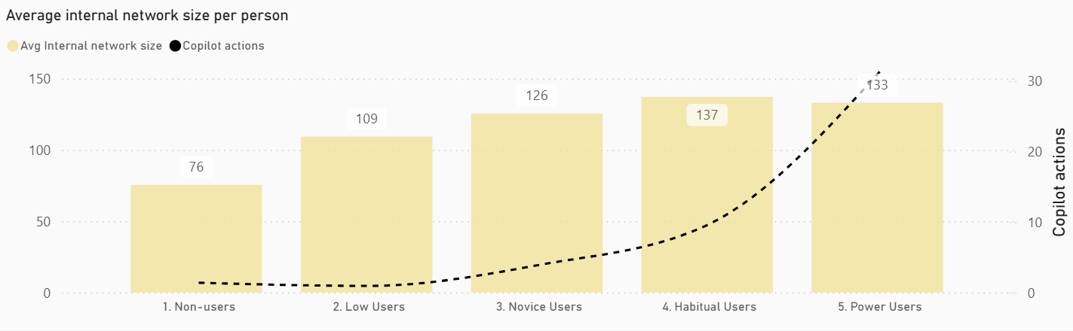
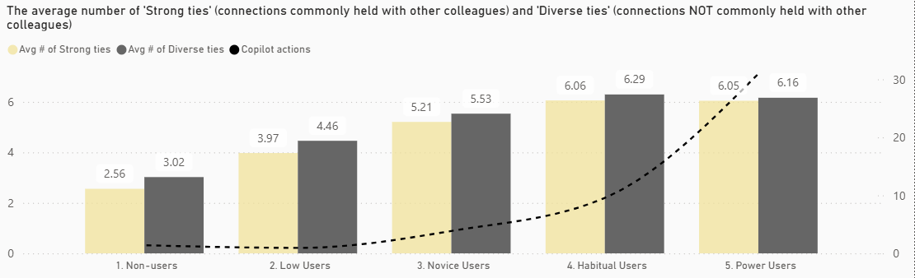
Larger, stronger, and more diverse networks among the most active Copilot users
Impact
Networks and Ties among Copilot users
Example visual
Takeaways
Frequent users of Copilot are more connected as they have larger internal networks increasing the likelihood of collaboration
Frequent users of Copilot have more diverse ties, which means they are interacting with a wider network of people in the organization, breaking down silos

Slide 21
Appendix

Slide 22
Recap and Next steps
Overall trends:
Acceleration in Copilot adoption with weekly actions taken increasing ___% over the last ___ months.
___% have formed a habit with Copilot. This number is increasing ___% monthly
___ and ___ are the habit-forming surfaces/actions.
ROI:
Positive ROI of ___ seen among __% of employees, with org ___ showing highest returns at ___X investment.
Improvement in usage within the bottom 25% and increasing license allocation will further amplify ROI
Work Impact:
Copilot is a core part of workflow in ___, ___, ___. Interviews planned to get a deeper understanding of use cases.
Increase in external collaboration and decrease in after hours seen among groups with high Copilot usage.
Enablement:
Identified transcription and recording policy as a blocker for adoption. Additional discussion planned to unblock
Role modelling, leadership sponsorship identified as an accelerant to drive adoption.
Targeted enablement for groups ___, ___, ____
Rollout/Allocation:
____, ____, _____ groups to be prioritized for new license allocations based on past adoption patterns.

